Slide 1
Using at the University of York
Stephen Gow: Learning Enhancement Team
www.york.ac.uk/integrity
integrity@york.ac.uk

Slide 2
Academic Integrity Resources
Academic Integrity Tutorial &
Research Integrity Tutorial
Referencing Style Guides and website www.york.ac.uk/integrity
Integrity@york.ac.uk – email
Online training and workshops + Departmental Workshops

Slide 3
Session Overview
In this 50min session we will:
Introduce the Turnitin text-matching software;
Explain Turnitin’s capabilities in assessing the originality of assignments;
Clarify how staff can ethically use Turnitin with student groups;
Clarify on what basis University of York students are given access to Turnitin to support their learning
Notes:
This session will:
Introduce the Turnitin text-matching software;
Explain Turnitin’s capabilities in assessing the originality of assignments;
Clarify how staff can ethically use Turnitin with student groups;
Clarify on what basis University of York students are given access to Turnitin to support their learning

Slide 4
Turnitin Facts and Figures
Text matching software
Database
45 billion webpages
337 million student papers
130million articles
A growing foreign language database
Turnitin does not detect plagiarism nor is it a substitute for academic judgement.
Turnitin is just one resource/ tool to hand.
See: www.submit.ac.uk and http://www.ithenticate.com/plagiarism-detection-database/)
Notes:
Turnitin matches the text of a document with text in sources in its database. It doesn’t match images/ diagrams. Doesn’t accurately/ reliably match equations/ formulae/ source code.
It does not detect plagiarism, which is an academic judgement:
What is plagiarism and what is acceptable use of material?
What is intentional plagiarism and what is a result of poor academic practice?
SafeAssign is available through Blackboard, but is a slower, less sophisticated text-matching tool. It might pick up sources Turnitin doesn’t. Google searches can assist with locating plagiarised material, also being familiar with the reading list and non-digitised sources to which students are directed. Looking for changing writing style, sentence structure, formatting helps too.
Turnitin has a vast database of electronic sources and student essays:
There are two way in which files are stored by Turnitin, as set by instructors:
In the repository – enabling documents to be matched against others
In the institutional database – stored by Turnitin, but not included in the repository.
The language capabilities mean Turnitin can match papers to sources in major European languages, Asian, Cyrillic and Arabic languages.
It is also developing tools to detect where text has been read in English and translated into another language.

Slide 5
We are going to look at some examples. What do you think Turnitin is highlighting? Write your answer in the CHAT box

Slide 7
Plagiarism!!!!!!

Slide 8
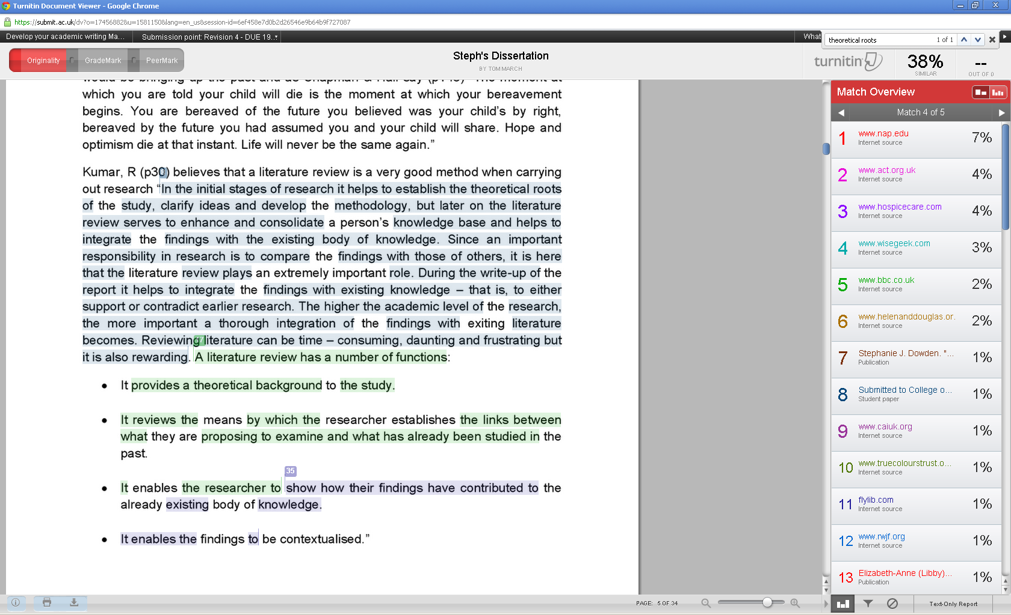

Slide 9
Quotation!!!!!

Slide 10
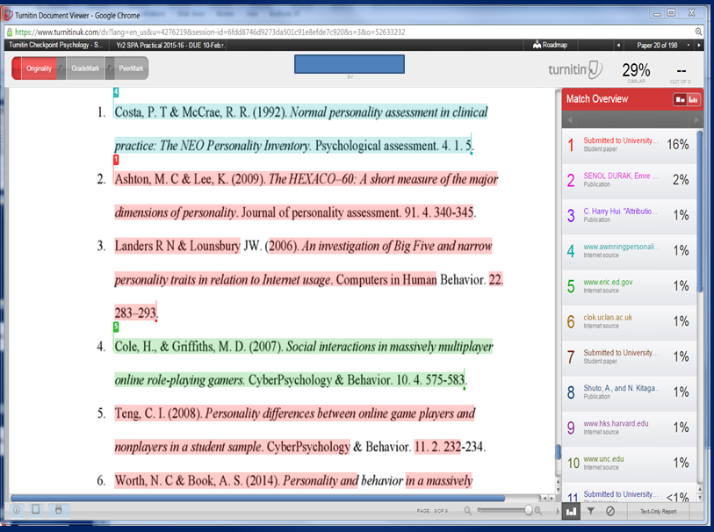

Slide 11
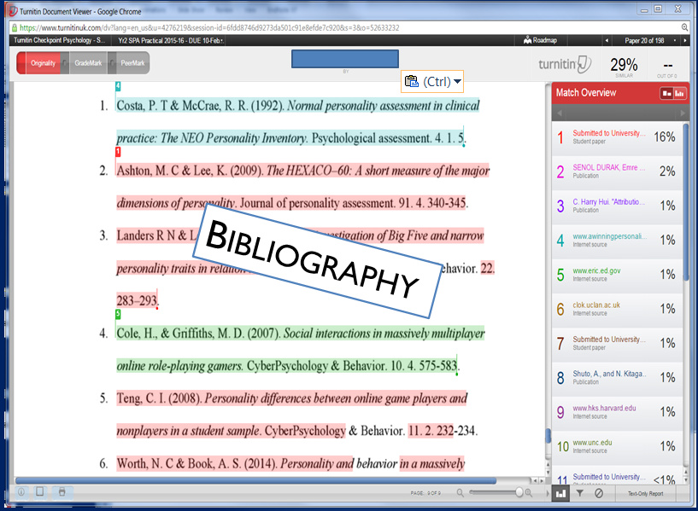

Slide 12
Common Text Matches
Unacceptable:
Copied text without acknowledgement
– potential plagiarism
Acceptable
Quotations
Bibliography
Common phrases
Specialist terms
Meta-language

Slide 13
Text matches
No percentage is safe
Consider the text match and decide if it has been appropriately cited/quoted.
Average match is between 10-20%
Percentages depend on the type of assignment & discipline

Slide 14
Where do I find Turnitin?
Turnitin is located in the Yorkshare VLE
Different types of Turnitin VLE sites:
Individual Staff Checkpoint
Module/course/class checkpoints
Student Checkpoints

Slide 15
Using Turnitin at York
Staff can:
Routinely use Turnitin as part of electronic submission for whole class cohorts
Use Turnitin on a case-by-case basis to examine suspicious work.
Notes:
Turnitin can help students to understand how to apply the principles of academic integrity by, for example, better integrating source materials and writing about them in their own words as opposed to patch writing and failing to acknowledge sources*.
Access to Turnitin is managed through the VLE for student training and use for assessment and plagiarism investigations.
*For example, see:
Davis, M. (2008). Creating Learning And Unlearning Opportunities From Turnitin In The Process Of Academic Writing. In S. Walker, M. Ryan and R. Teed, eds. Designing for Learning e-learning@greenwich/conference:
Post-Conference Reflections and Abstracts. Greenwich: University of Greenwhich, pp. 41-46.
Rolfe, V. (2011). Can Turnitin be used to provide instant formative feedback? In British Journal of Educational Technology, 42(4), 701-710.
Stappenbelt, B. and Rowles, C. (2009). The effectiveness of plagiarism detection software as a learning tool in academic writing education. 4th Asia Pacific Conference on Educational Integrity (4APCEI) 28–30 Sept 2009. University of Wollongong NSW Australia. http://ro.uow.edu.au/cgi/viewcontent.cgi?article=1029&context=apcei&sei-redir=1&referer=http%3A%2F%2Fscholar.google.co.uk%2Fscholar%3Fq%3Dturnitin%2Bwriting%26btnG%3D%26hl%3Den%26as_sdt%3D1%252C5%26as_ylo%3D2008#search=%22turnitin%20writing%22
Starr, S. and Gaham-Matheson, L. (2011). Efficay of Turnitin in support of an institutional plagiarism policy. A report for plagiarismadvice.org on research conducted at Canterbury Christ Church University. http://www.plagiarismadvice.co.uk/images/documents/starr_04.pdf

Slide 16
Using Turnitin at York
Students can:
Attend a 1 hour workshop organised with departments or open lunchtime session. (A distance workshop is available for distance and part-time students only.)
Use Turnitin to develop writing and integrity.
Notes:
Turnitin can help students to understand how to apply the principles of academic integrity by, for example, better integrating source materials and writing about them in their own words as opposed to patch writing and failing to acknowledge sources*.
Access to Turnitin is managed through the VLE for student training and use for assessment and plagiarism investigations.
*For example, see:
Davis, M. (2008). Creating Learning And Unlearning Opportunities From Turnitin In The Process Of Academic Writing. In S. Walker, M. Ryan and R. Teed, eds. Designing for Learning e-learning@greenwich/conference:
Post-Conference Reflections and Abstracts. Greenwich: University of Greenwhich, pp. 41-46.
Rolfe, V. (2011). Can Turnitin be used to provide instant formative feedback? In British Journal of Educational Technology, 42(4), 701-710.
Stappenbelt, B. and Rowles, C. (2009). The effectiveness of plagiarism detection software as a learning tool in academic writing education. 4th Asia Pacific Conference on Educational Integrity (4APCEI) 28–30 Sept 2009. University of Wollongong NSW Australia. http://ro.uow.edu.au/cgi/viewcontent.cgi?article=1029&context=apcei&sei-redir=1&referer=http%3A%2F%2Fscholar.google.co.uk%2Fscholar%3Fq%3Dturnitin%2Bwriting%26btnG%3D%26hl%3Den%26as_sdt%3D1%252C5%26as_ylo%3D2008#search=%22turnitin%20writing%22
Starr, S. and Gaham-Matheson, L. (2011). Efficay of Turnitin in support of an institutional plagiarism policy. A report for plagiarismadvice.org on research conducted at Canterbury Christ Church University. http://www.plagiarismadvice.co.uk/images/documents/starr_04.pdf

Slide 17
Staff Use for Misconduct Monitoring and Detection
Students accept the Ordinance and Regulations stating text-matching software may be used here.
Please make students aware if you will be using Turnitin, and how, when assessing work.
Training is available for staff on using Turnitin and interpreting originality reports.
Notes:
It is important that students are made aware of when departments are using Turnitin and in what circumstances, and that they know they have the opportunity to learn how to use it themselves to develop their writing.
It is important to think about the ethical and transparent use of Turnitin as part of efforts to develop an ethos of education and preventing misconduct, rather than of generating fear about plagiarism and collusion and a focus on detection and punishment.

Slide 18
Informing Students
4.8.3 - Staff submission of student work to SafeAssign or Turnitin
To ensure the highest levels of academic integrity and in line with University Regulation 5.7b staff have the facility to submit student work to the text matching packages - SafeAssign® and Turnitin®. In accepting the University Regulations on admission, students have agreed to the University’s use of these software packages. However, as submitting student work to these software packages involves sharing student work and data with a third party, departments and staff should
a) clearly state their policy regarding the use of SafeAssign or Turnitin to all students in programme and module information.
b) follow the VLE guidance available at ‘Setting up the TurnitinUK assignment tool’
OR
‘Setting up a SafeAssignment submission point’
Guide to Assessment, Standards, Marking & Feedback, p. 14
http://www.york.ac.uk/about/departments/support-and-admin/registry-services/guide/
Notes:
This is the wording of the Guide to Assessment regarding the use of text-matching software.

Slide 19
Student use of Turnitin

Slide 20
Students’ Formative Use
Student completes their draft
Uploads the work to Turnitin
Revises the draft to submit
Analyses the originality report
Students have 25 submission points
realistically they will check work once or twice
No staff involvement in the process
Notes:
Staff in the department (usually) do not have access to the Originality Reports students generate when they formatively use Turnitin following a training workshop.
Students are using it in a ‘safe’ space to check their work and develop their writing ability.
Work they upload is stored by Turnitin, but is not included in the matching repository (hence why work submitted for assessment and checked through Turnitin does not match to itself).

Slide 21
Question
Please type your answers into the CHAT box:
What are the potential benefits
of students using Turnitin?

Slide 22
Question
Please type your answers into the CHAT box:
What are the potential drawbacks
of students using Turnitin?

Slide 23
Staff use of Turnitin

Slide 24
Staff Use
When investigating misconduct, appeals could scrutinise Turnitin’s use.
Regarding matches – quality not quantity is important.
Consider the type;
Consider why;
Use the filter functions to see the full picture.
Originality reports can be a stimulus for writing feedback.
Notes:
If students appeal misconduct decisions the way in which the department has used Turnitin to reach its decision could affect the outcome – this could be internal only or in worse cases could reach the OIAHE.
We work on the principle that there is no safe or suspicious percentage match threshold, as Turnitin does not detect plagiarism, nor include all sources students will use.
It is important to assess what matches and to consider why that might be. (Types of match are explained on a later slide).
The filter functions can help to more efficiently and effectively analyse the reports to focus on more problematic matches – but use them carefully.
If using Turnitin for formative assignment submission the reports can be useful in suggesting aspects of writing on which to give students feedback.

Slide 25
Do you know what your department’s approach with Turnitin is? (and who to speak to about it?)

Slide 26
Individual assignment checking
Turnitin Checkpoint [Dept.] – Staff only
Student submits assignment electronically
Staff mark assignment but are suspicious of plagiarism
Staff can submit individual assignment to Turnitin

Slide 27
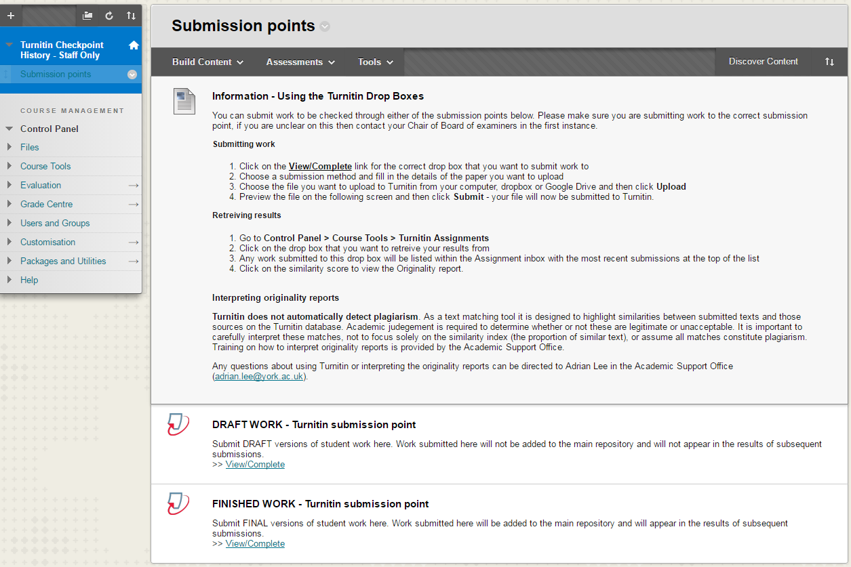

Slide 28
Cohort assignment checking
Students submit there assignments
Admin downloads all assignments and uploads a Zip into Turnitin
Admin carries out quick check of percentages for whole cohort
Admin informs markers of high percentages outliers
Markers can access all papers and check for plagiarism

Slide 29
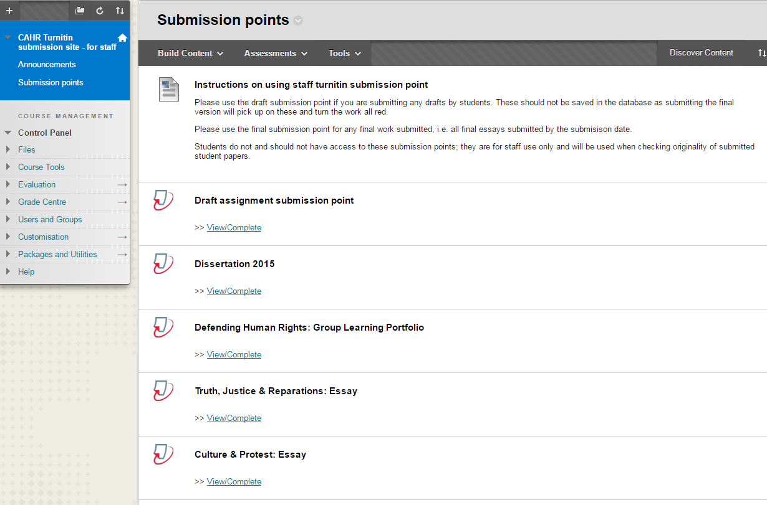

Slide 30
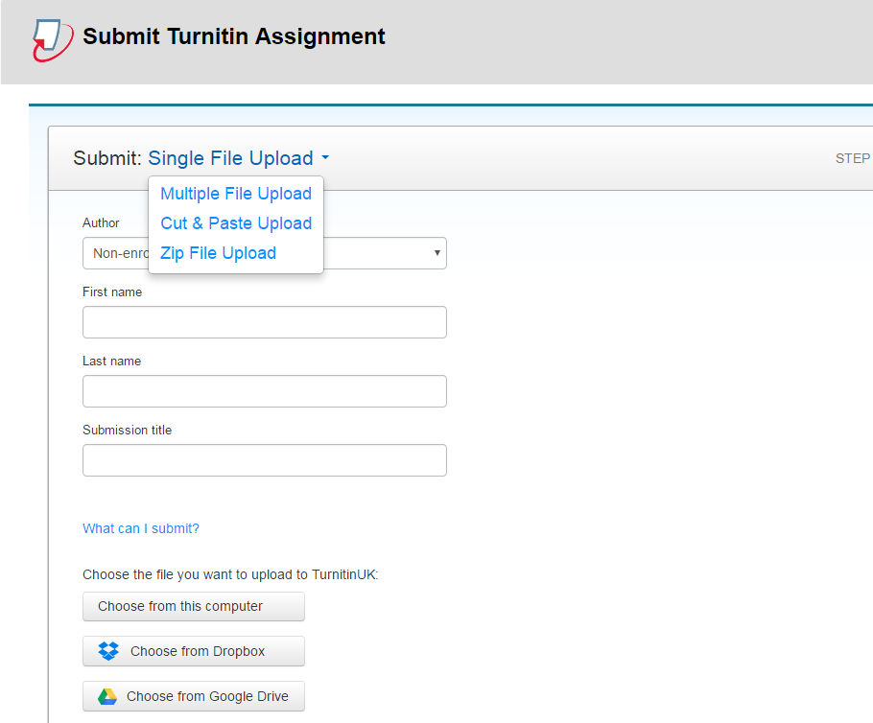

Slide 31
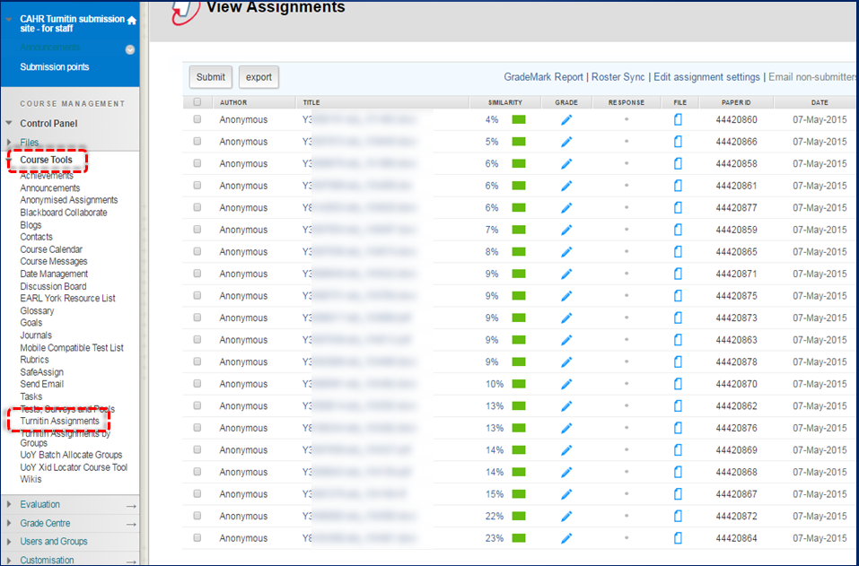

Slide 32
Common questions/problems
How do I get added to a Turnitin VLE module? – email integrity@york.ac.uk with a request.
Do not delete a checkpoint as this does not delete the papers from Turnitin
If you do get 100% this is usually a duplicate submission.
If you wish to delete a paper, then the Turnitin administrator (integrity@york.ac.uk) can do this but it takes a few days.

Slide 33
Questions
I previously used Turnitin at [another institution]. I am interested in how the University of York use/or propose to use Turnitin?
We have just started to use electronic submission. Does this then mean that staff could start using Turnitin to spot academic misconduct? If so, I would like to know the basics of how we would go about this. If staff use it, should we also make it available to students, or is it already available to students?
Aside from it is for detecting plagiarism, I have no idea how to use it or interpret the results. How 'reliable' a guide is it?
As a lecturer do I need to check work? Or will I automatically be notified if there is a concern?

